Slide 1
How to install external sequence at Siemens systems
Based on host IDEA version VE11
And FWF patch version 1.13 (and later)
Filip Szczepankiewicz, 2018-04-30

Slide 2
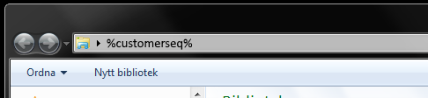
Copy the sequence files to %customerseq%
Log in as advanced user. Normally by opening the start (press windows button, or Ctrl + Esc) and selecting ”Advanced User”
Password is provided by Siemens
Insert the media that contains the sequence files (USB stick). Copy the relevant files to the customer sequence folder
Usually, two files need to be copied (.dll and .so)
Acess the correct folder by typing %customerseq% in an explorer window and press enter.
Hint: It is likely that %customerseq% points to C:/Medcom/MriCustomer/seq/

Slide 3
Create a valid waveform library (not applicable if you have ”s” version)
Create a common library folde where generic waveforms are stored
The path is: %customerseq%/FWF_Library/COMMON/
This folder should be populated by
FWF_OPTICUBE03.txt, FWF_OPTICUBE12.txt, FWF_OPTICUBE21.txt
For > V1.07 it also includes FWF_TRAPXXX.txt and FWF_BITRAPXXX.txt
Insert your own waveforms in one of the study folders
The path is: %customerseq%/FWF_Library/STUDY_*/
The ”*” can be 01, 02,… 20
In each study folder you can keep 16 pairs of waveform files
These are named: FWF_CUSTOM*_A.txt and FWF_CUSTOM*_B.txt
The ”*” can be be 001, 002, … 010
The _A and _B are played before and after the refocusing pulse
Hint: Don’t modify waveform files that you do not own – it may ruin someone’s setup.

Slide 4
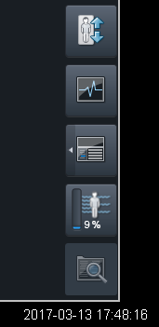
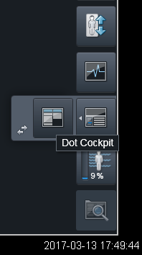
Open the parameter editor
Click the little white arrow next to the dot cocpit icon
The program editor icon should appear
Click theprogram editor icon
Tip: Sometimes the Dot Cocpit and the Program editor icons are switched. In that case, you don’t need to click the white arrow to expand the menu.

Slide 5
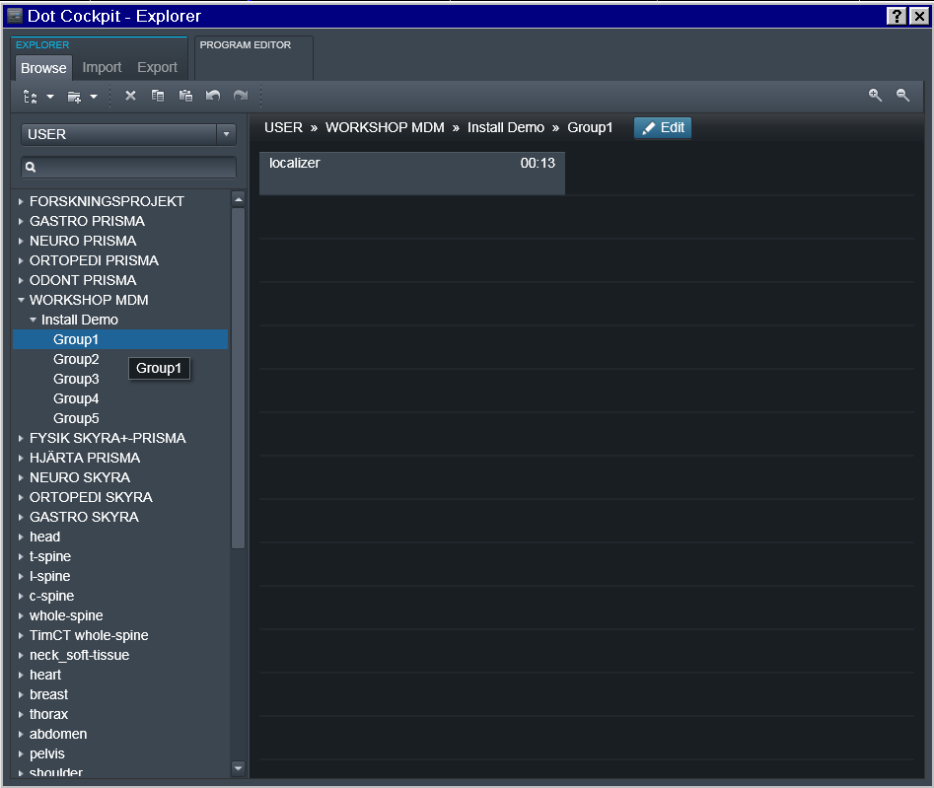
Select a work folder
Navigate to an appropriate folder, and select it by clicking its name
We call this the ”work folder”
Click the ”Edit” button to enter the program editor
Tip: To insert sequences, you must be at the lowest level of the system tree. There are three levels. In the example these are: WORKSHOP MDM/Install Demo/Group1

Slide 6
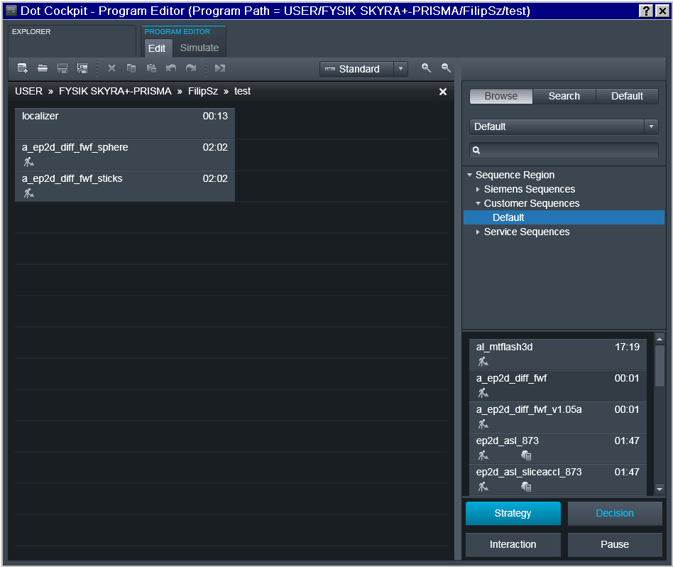
Import the sequence from customer seq
Click the ”Browse” tab
Select ”Default” in drop down
In the list below, navigate to
Sequence Region
Customer Sequences
Default
The sequence appears in the list.
Drag-and-drop the appropriate sequence into the work folder
Only one object is moved this way, but both .dll and .so are installed by doing so.
Tip: If the sequence does not appear in the list, it may be compiled for the wrong software version.

Slide 7
The sequence is now imported!
The imported exam card can now be used on the scanner
Note that the standard settings are not meant to be used for actual imaging
If you could not find the sequence in the previous step, it is possible that the sequence is incompatible with your system.

